Slide 1

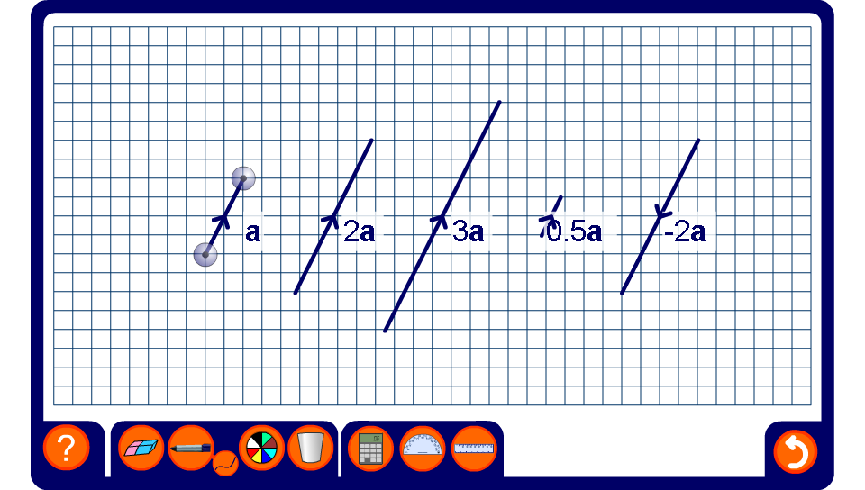


Multiplying vectors by scalars
Notes:
Modify vector a by dragging on its end-points. Observe how the scalar multiples of the vector change.

